Slide 1
Building gen-AI bots with Teams Toolkit & Teams AI library for .NET
Ayça Baş
Senior Cloud Advocate
@aycabs
John Miller
Senior Product Manager
@jmillerdev

Slide 2
Agenda
Overview of the Teams Toolkit for Visual Studio
Building your first Teams app with Teams Toolkit
Overview of the Teams AI library for .NET
Integrating your Teams app with generative AI using Teams AI library
Resources

Slide 3
Overview of Teams Toolkit
Teams Toolkit for Visual Studio

Slide 4
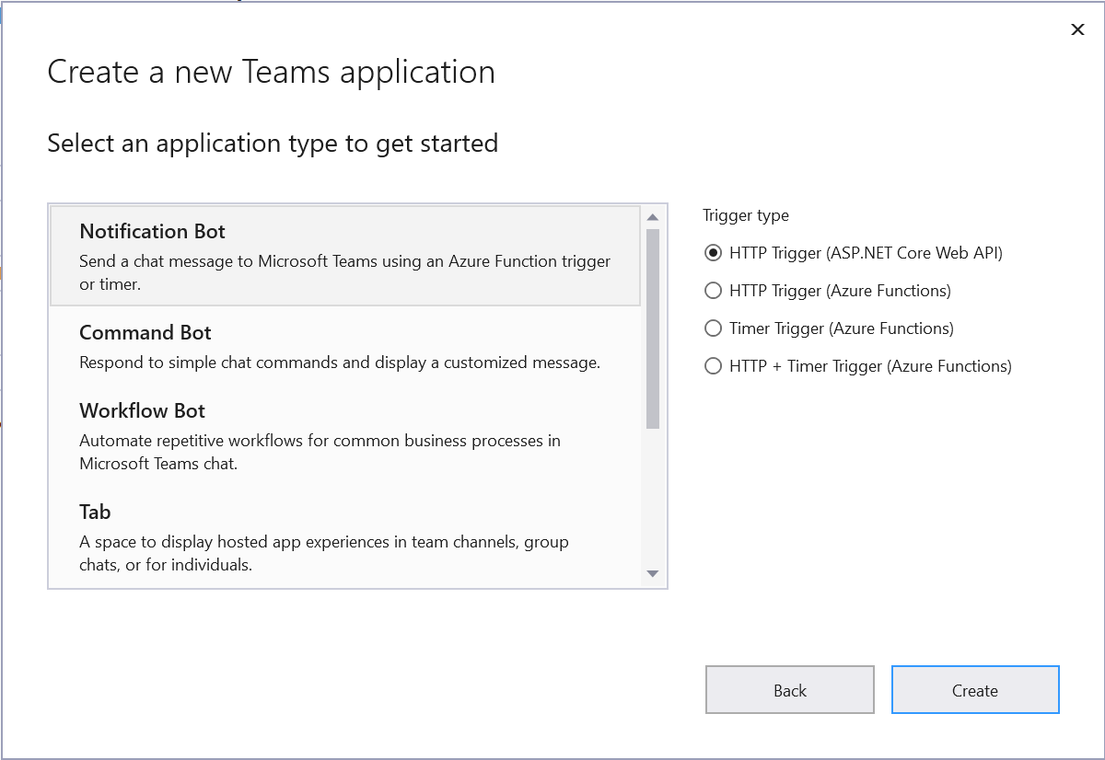

Why Teams Toolkit?
Simple way to get started with project templates​
Save time with automatic app registration​
Smart defaults for hosting in Azure​
Use .NET!​

Slide 5
What’s new with Teams Toolkit for Visual Studio?
New project templates for Teams apps
Dev Tunnels for Teams Toolkit
Custom provisioning

Slide 6
Demo
Building your first Teams app with Teams Toolkit

Slide 7
Teams AI library
For .NET developers

Slide 8
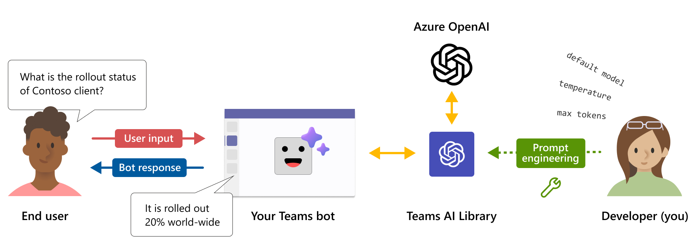
Teams AI library
NOV 30
Currently available as preview on GitHub
NOV 30
Teams-centric interface to GPT-based language models
Helps developers create intelligent Teams apps with large language models (LLM) quickly
Provides simple capability-driven approach

Slide 9
The building blocks of the library
Application​
Turn State​
AI Module​
Replaces the Activity Handler class in a Bot Framework bot
Stores temp and conversation user state
Encapsulates all the components and methods related to AI
Components
Prompts
Actions
Chains
Notes:
Application: Replaces the Activity Handler class in a typical Bot Framework bot. All components, including AI, are registered to the application singleton instance.
Turn state: used to store temp, conversation, & user state. All Bot Framework storage providers supported.
AI module: Encapsulates all the components and methods related to AI in this SDK.
Inside AI module components:
Planner: takes user prompt and returns a plan on how to accomplish the request
Prompt Manager: manages prompt templates.
Moderator: moderates user input and LLM output. It can be configured to use any LLM moderation APIs
Prompts is a folder that contains:
skprompt.txt: the prompts text and supports template variables & functions
config.json: the prompts model settings
The prompt is fed into an LLM planner to create a plan.
Actions: Actions are delegate functions that make up the basic building block of the plan.
Synonymous to "app skills"
The SDK provides a few built-in actions.
SAY action will send model's response to the user in Teams.
Part of the AI Module
Chains: Chain is a method than runs the end-to-end flow of generating a plan and executing it.
It is the primary method used in the AI module.

Slide 10
Demo
Powering your Teams app with generative AI using Teams AI library

Slide 11
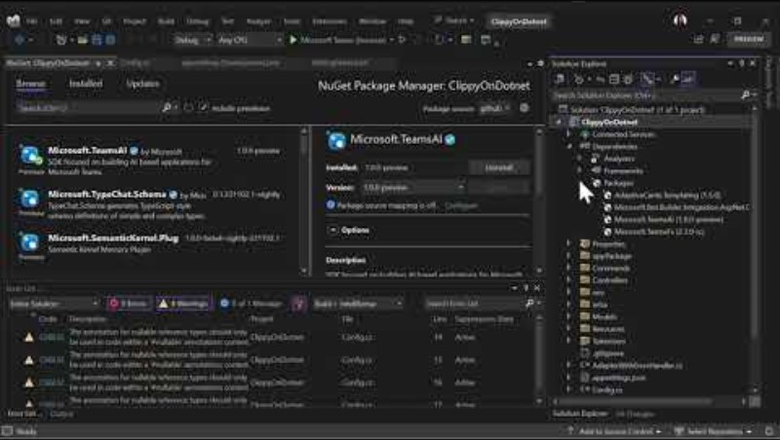

Slide 12
What’s next?
Visual Studio 17.9
Coming soon
Project templates and support for M365 Copilot Chat plugins
Upgrade Tab project to latest Blazor and .NET 8
Project templates and support for Teams AI SDK apps
Preview Adaptive Cards
Simplified bot debugging
Better support for large app solutions
C# Dev Kit in VS Code
Better support for migrating existing projects or templates
And more!

Slide 13


Resources
Teams Toolkit for Visual Studio docs: https://aka.ms/ttk-vs-docs
Teams Toolkit GitHub: ​ https://aka.ms/ttk-github
Teams Toolkit Samples:​ https://aka.ms/ttk-samples
Teams AI library GitHub: https://aka.ms/teams-ai-github

Slide 14
Share your feedback
https://aka.ms/ttk-vs-feedback

Slide 15
Download .NET 8
https://aka.ms/get-dotnet-8

